Slide 1

NDSM System®
Nabir Migadde
Dan Blumenschein
Shay Hameed
Melanie Sou

Slide 2

Problem Description
Finds information about a product
Ex: stock availability, price, number of items, location
Prompts user to input a product, number of items, price, Y/N for stock availability,
After inputting the information, the program will sort product name by user’s choice of alphabetical order or the price by ascending or descending order

Slide 3
Major C++ Components
Input data: name of item, price, location, stock availability,
While loop: data validation, re-prompts user
If/else statement:
Switch/Case: choice of sorting
For loop: executes the sorted output repeatedly
I/O files: items
Functions, Vectors, & Pointer: product sorting by alphabetical order and price sorting by descending or ascending order
Output Data: sorted product with corresponding numbers of items, price, location,

Slide 4
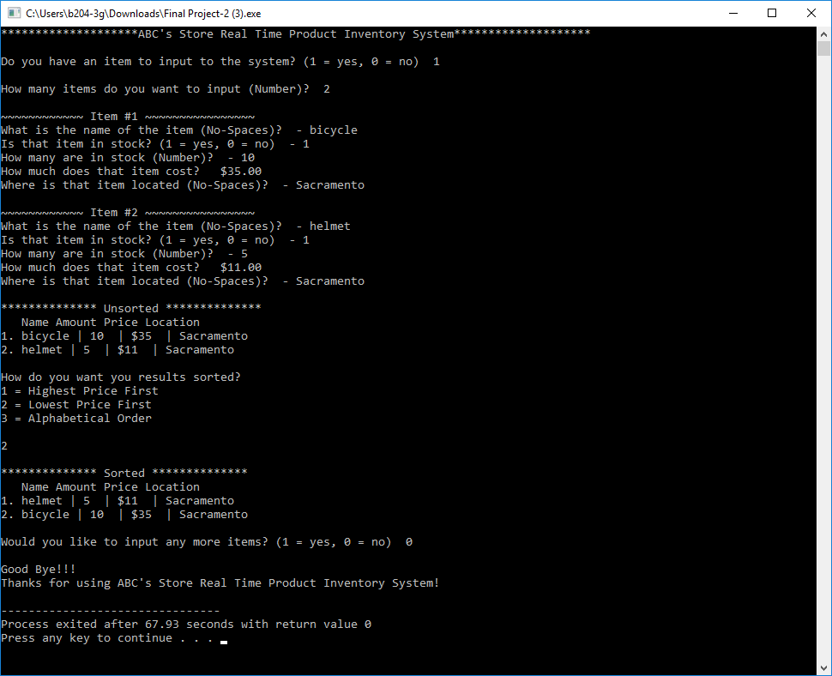

Slide 5

Tasks Lists and Assignments
Shay Hameed- Input data, functions,
Melanie Sou- Data validation, array
Nabir Migadde- Searching, bubble sorting, I/O file, vectors,
Dan Blumenschein- Output data, functions

